Slide 1

Delicacy Express System
Mi Gao, Peiyan Duan, Xi You

Slide 2
Project Overview
Nowadays, the lives of students and professionals are becoming increasingly busy, leaving less time to enjoy food.
A quicker means of receiving food becomes more important.
Our application Delicacy Express System serves as a backend for a food ordering and delivery service for customers and restaurants.

Slide 3
Project Description
The system will build a database that will allow the users of the delicacy express system to check up restaurants, browser menus, and keep track of orders.
The backend database supports functionalities including create, retrieve, update and delete entries. We designed six schemas in the database.

Slide 4
Database Schema
The main entities are Restaurant, Dish, Customer, Order, and Review.
Restaurant { res_id, res_address, res_name, phone_number, res_description}
Dish { dish_id, dish_name, dish_price, dish_wait_time, rest_id, dish_description}
Customer{ cus_id, cus_name, cus_address, phone_number}
Order { order_id, cus_id, res_id, order_cost, date_time, total_wait_time}
DishOrder {order_id, order_type, dish_id, custom_cost, custom_name}
Review { order_id, order_type, cus_id, res_id, taste, delivery_rate, service_rate, recommendation_rate}

Slide 5
Database Creation
Generally, we created the database via pgAdmin. We designed data to test our complex queries for filtering dishes and restaurants, as well as eliminating any potential data redundancies. Our “INSERT INTO” contains data type constraint, not null constraint, primary and foreign key constraint etc. Also, we injected the set of data by using JDBC and Python for each specific table additionally for saving a bunch of time.

Slide 6
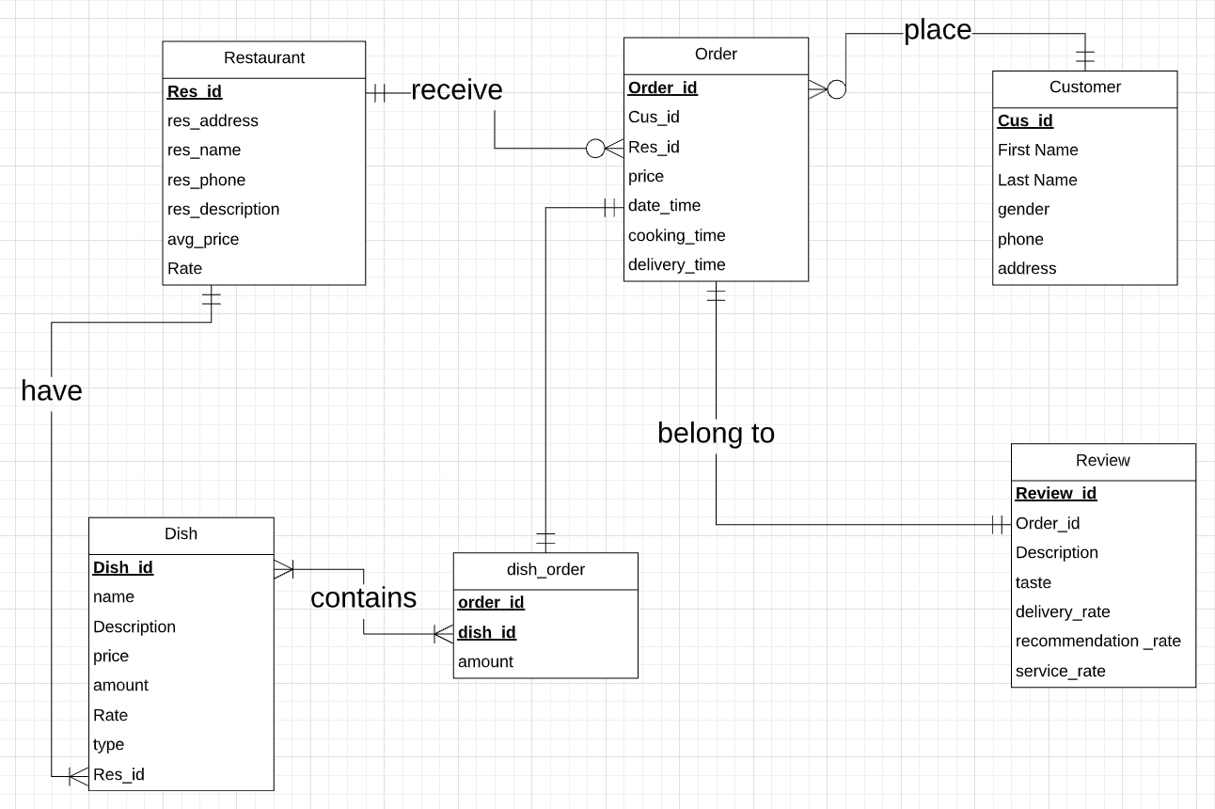
ERD

Slide 7

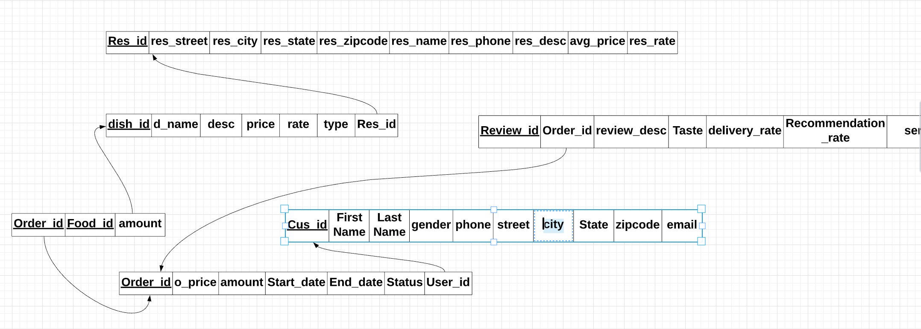
Logical design

Slide 8
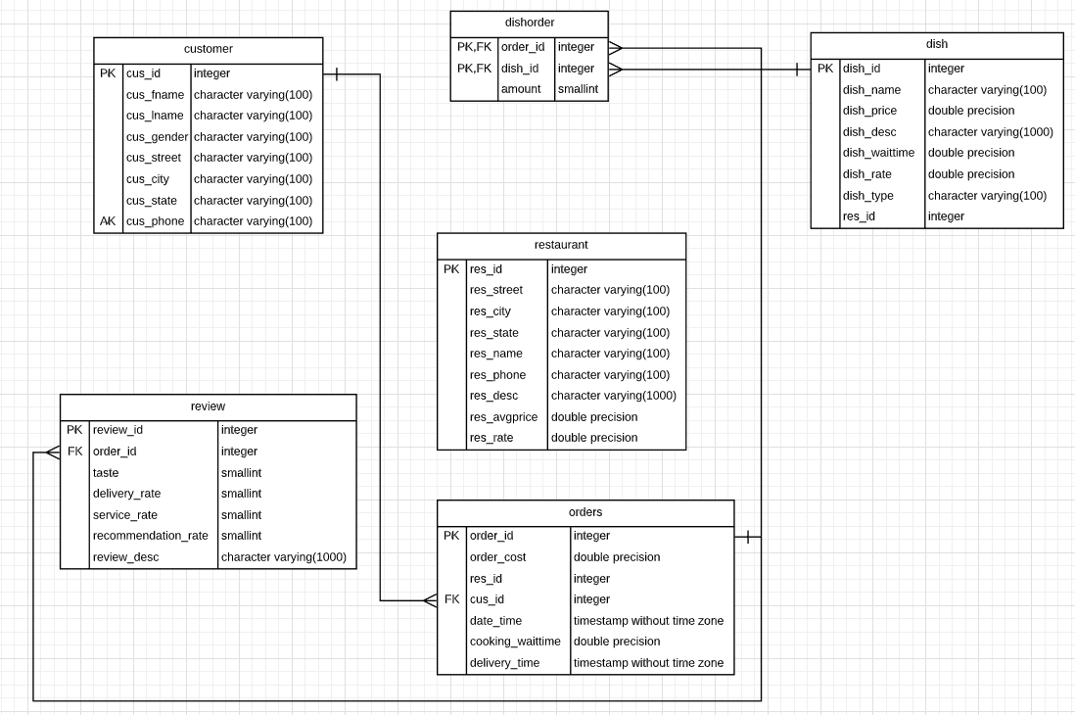
Physical design

Slide 9

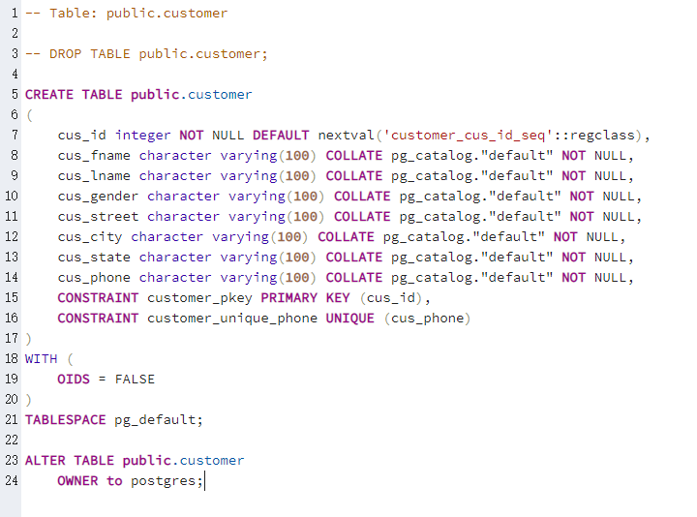
CREATE TABLE public.customer

Slide 10
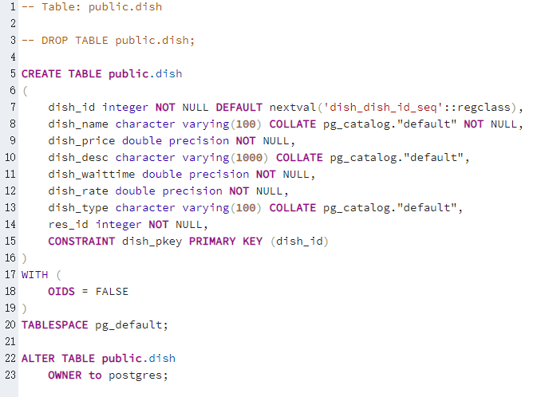
CREATE TABLE public.dish

Slide 11
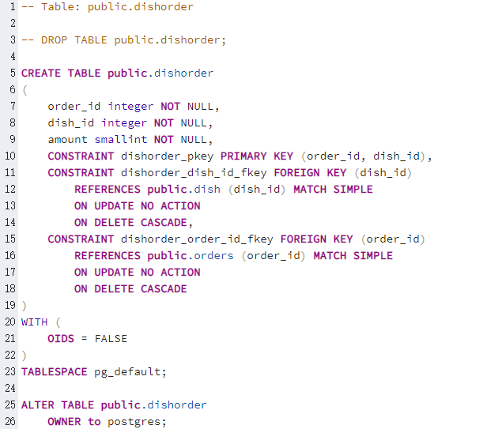
CREATE TABLE public.dishorder

Slide 12
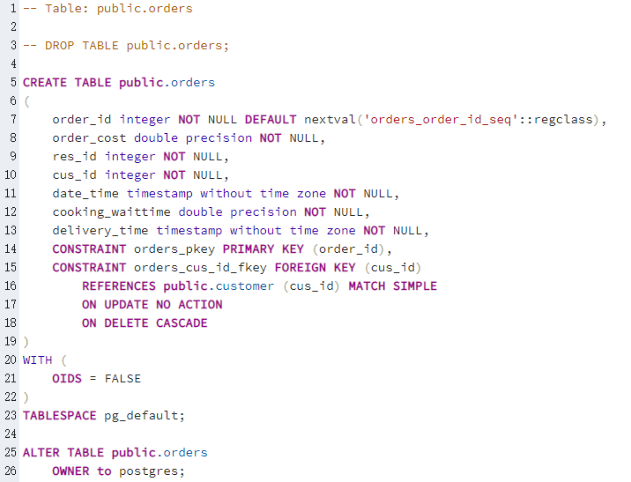
CREATE TABLE public.orders

Slide 13
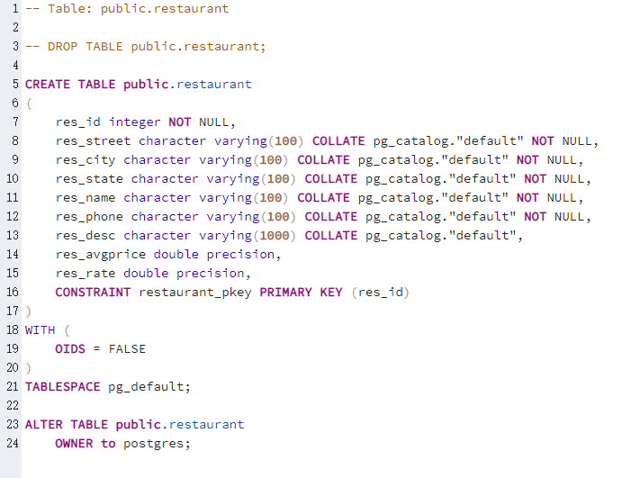
CREATE TABLE public.restaurant

Slide 14
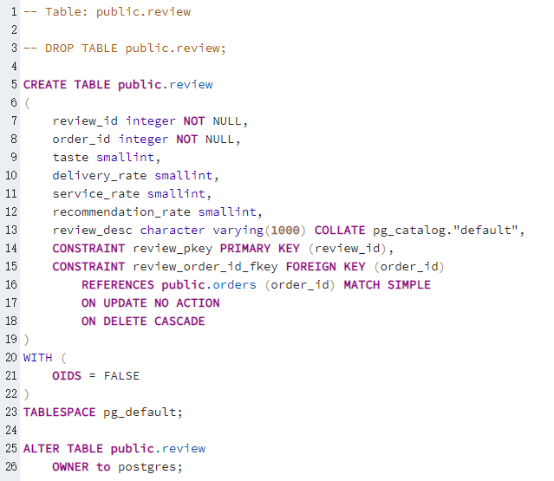
CREATE TABLE public.review

Slide 15
Triggers & Views

Slide 16
Triggers/functions
Trg_status_dishorder_total_insetrg (under TABLE dishorder)
fn_status_dishorder_total_insert
Calculating total cost of dishes for each order.
Trg_status_loadavg_insert (under TABLE orders)
fn_status_loadavg_insert
Calculating average cost for every restaurant.

Slide 17
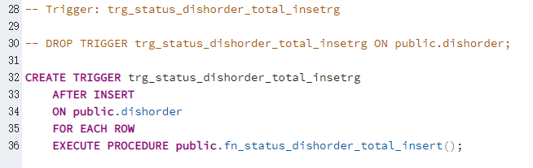
2. Trg_status_dishorder_total_insetrg (under TABLE dishorder)

Slide 18
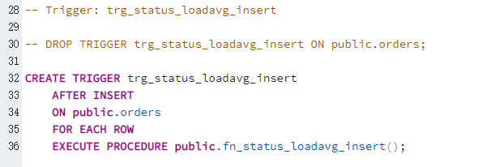
2. Trg_status_loadavg_insert (under TABLE orders)

Slide 19
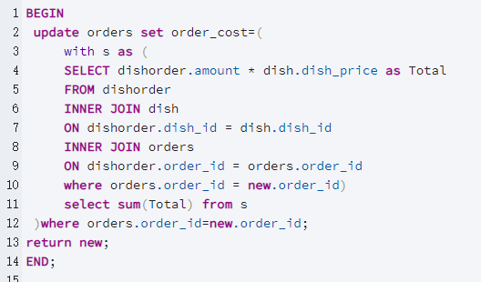
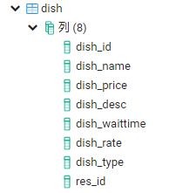
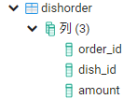
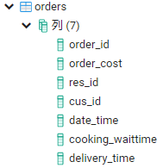
fn_status_dishorder_total_insert
Once a new dish has been add into an order, the total cost of a order will be updated.

Slide 20
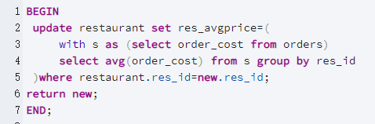
fn_status_loadavg_insert
Once the restaurant gets new order, its average cost will be updated.

Slide 21
Benefits of a Database View
Enforce Business Rules
Consistency
Security
Simplicity
Space

Slide 22
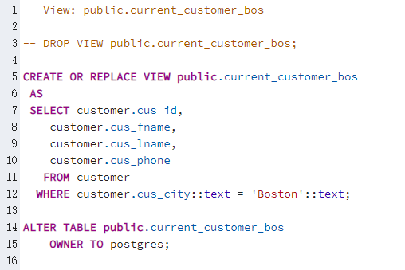
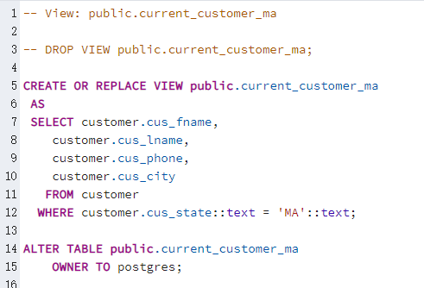
Views - checking(SELECT) data

Slide 23
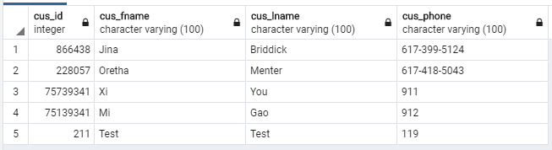
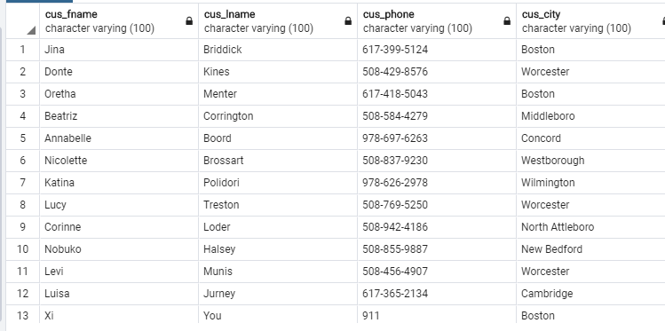
Views - checking(SELECT) data

Slide 24
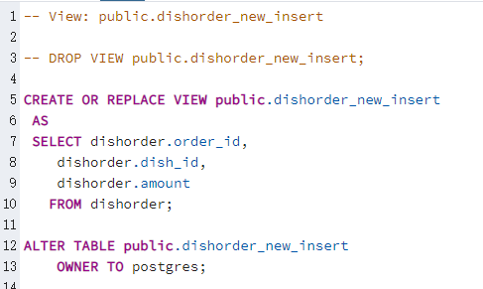
Views - inserting data

Slide 25
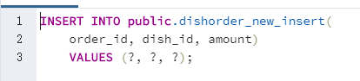
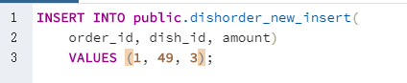
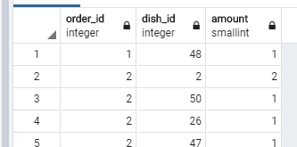
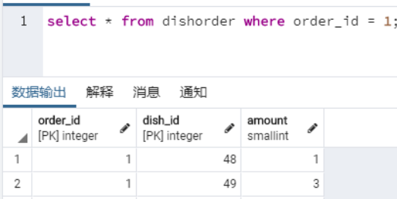
Views - inserting data
INSERT script:

Slide 26
Thank you!

